Slide 1

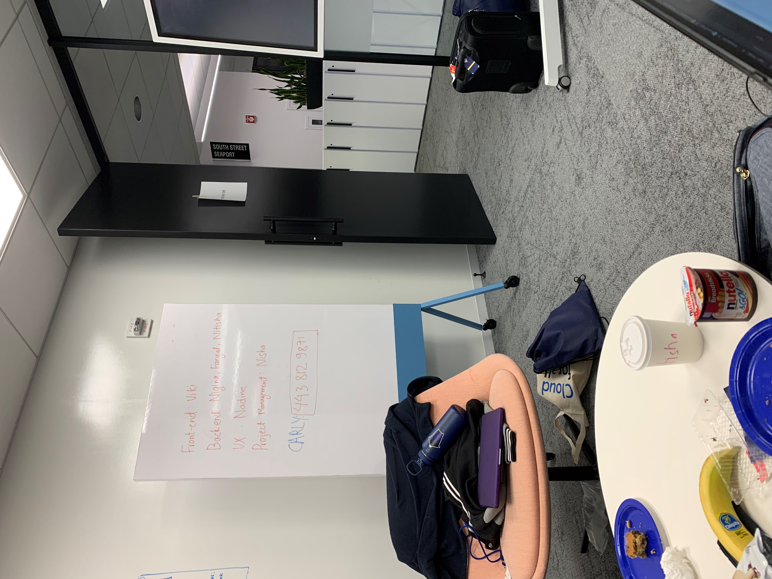
LINE UP QR CODE

Slide 2
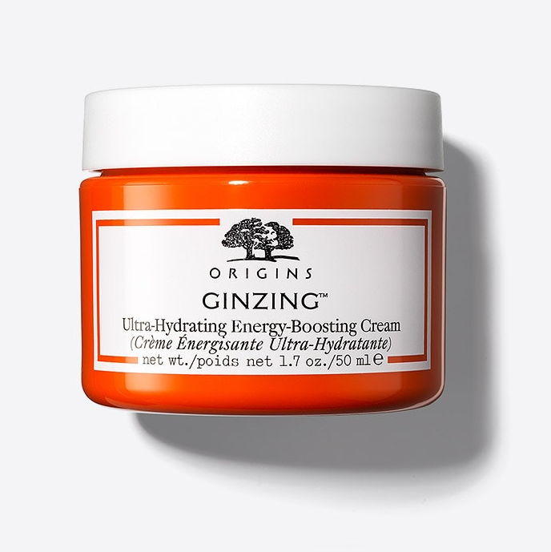
X
GINZING Ultra Hydrating, Energy-Boosting Cream
INGREDIENTS
Caffeine
ginseng
glycerin
MORE INFO

Slide 3
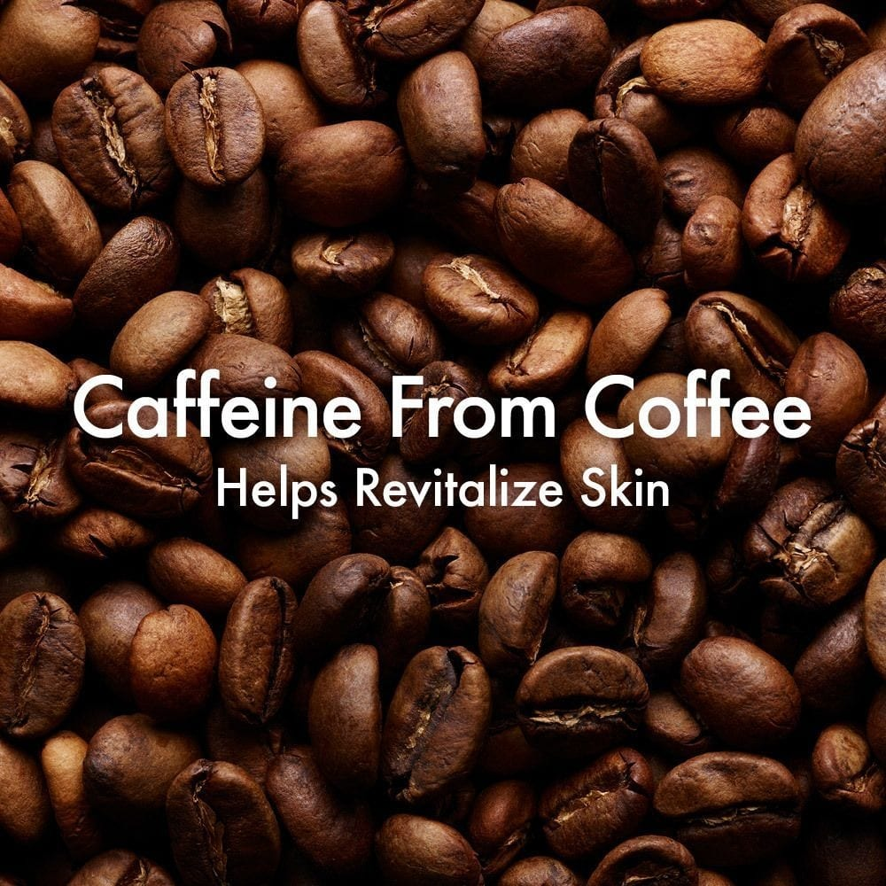
X
CAFFEINE
PURPOSE
Coffee & Ginseng help reenergize skin for revved up radiance. Skin looks & feels reawakened.
SOURCES
CAFFEINE FROM COFFEE BEANS
MORE INFO

